Slide 1
IML End Term Project Analyze and Solve the House price prediction Problem using different Regression Models
Divyansh Mohan – D21013
Kandarp Choudhary – D21016

Slide 2
Index:
Questioning the data and formulating initial hypothesis.
Exploratory Data Analysis.
Initial Linear Regression model fitting.
Feature Engineering
Backward elimination method
Trying a Decision Tree model to fit the data.
Testing the best competing models on test data and reporting the results.

Slide 3
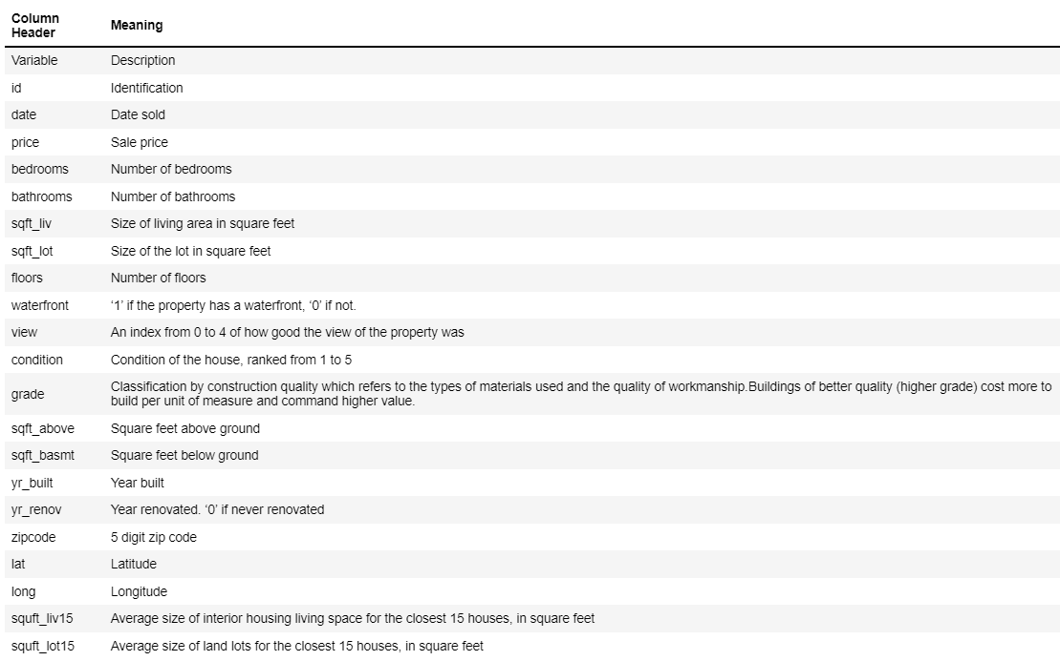
Questioning the data and formulating initial hypothesis:
Initial Questions towards data column names:
What is grade for?
What is sqft_lot 15?
What is sqft_living 15?
The table helps us answer the questions about the meaning of the columns.

Slide 4
Initial Hypotheses without doing EDA (Answers are written in () after EDA):
yr_built and price are negatively correlated (Wrong!, r=0.051759)
Having waterfront increases view rating, considering other factors remains similar (Yes, r=0.402725)
Price of the house will be positively correlated with condition (Wrong!, r=0.044732)
Number of bedroom will be positively correlated with number of bathrooms (Yes, r=0.506070)
Sqft_above will be positively correlated with number of bedroom (Yes, r=0.534801)
id is unique number (there are 41 duplicate entries in id)
id is not correlated with any column (Yes, id is not strongly correlated to any column)
sq_ft is positively correlated with price (Wrong!, r=0.094143)
Grade and house price are positively correlated (Yes, r=0.665567)
zipcode and price are positively correlated (Wrong!, r=-0.055629)
Number of bedrooms and price are positively correlated (Yes, r=0.300808)
*r = Pearson's correlation coefficient

Slide 5
Exploratory Data Analysis:
We have stored the continuous numeric columns from the dataframe in variable df_cont and the categorical numeric columns in df_cat.
Univariate Analysis:
We are plotting the barplots for all categorical columns stored in the df_cat variable.
Similarly, we are plotting the boxplot and histogram for all continuous numeric columns from the df_cont variable.We are using the subplot function to add the Histogram and Boxplot of a column in one single figure.
Bivariate Analysis:
Earlier we used one column at a time to plot the graphs which was Univariate analysis.Here we are comparing price column with all other columns using a scatterplot.We have kept the colours different for categorical and continuous columns.

Slide 6
Exploratory Data Analysis:
We found out the correlated columns with price which can be helpful in selecting our predictor variables using the corr() function.
Plotting scatter plot for the columns having some correlation.We are dropping the columns which show weak correlation with price
The columns that show weak correlation are "long","condition","id","yr_renovated","waterfront","zipcode","yr_built","sqft_lot","sqft_lot15“.
We also found out that 41 ids were duplicate as they represented houses that were sold multiple times.
Other EDA Observations:
sqft_above + sqft_basement = sqft_living
Most houses never renovated.
Most houses don't have waterfront.
Each Zipcode does not have unique longitude and latitude.

Slide 7
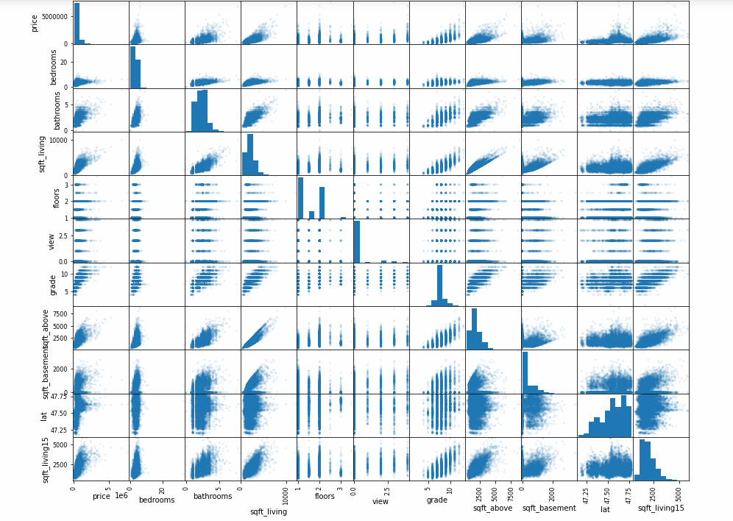

Slide 8
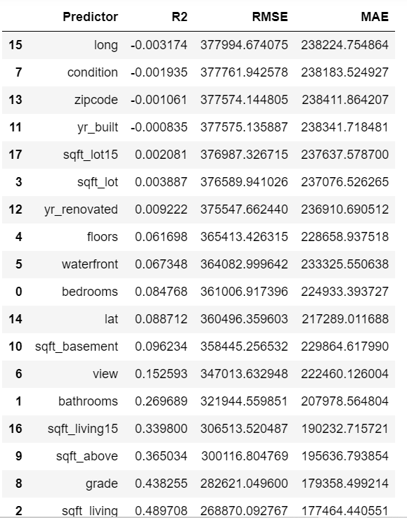
Initial Linear Regression model fitting:
Fitting Simple Linear Regression Models:
We are creating simple Linear Regression models where we our fixing our target variable to price and through a for loop we are iterating through all the columns in the dataset and finding out the cross validation score for R-square,RMSE and MAE metrics.
From the table we can see that the model with sqft_living as predictor has the highest R-square value 0.4897 and RMSE value 268870.09
The Mean absolute Error (MAE) explains on average, how much the predicted value deviates from the original value.

Slide 9
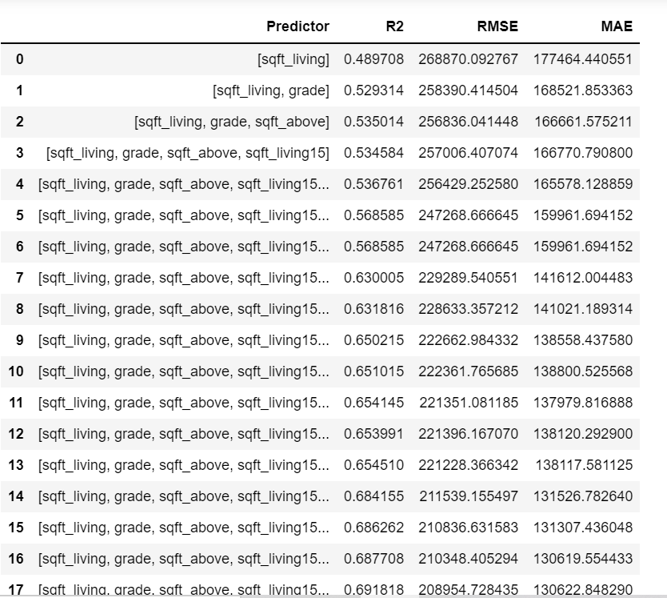
Initial Linear Regression model fitting:
Multiple Linear Regression Models
Creating a Multiple Linear Regression model where we our fixing our target variable to price and through a for loop we are adding a new predictor in each iteration and finding out the cross validation score for R-square,RMSE and MAE metrics. We are making a DataFrame which consists of predictors used and the cv score metrics.
So the model with the highest R-square value will also have the least RMSE and MAE in most cases.
From the table we see that including all the columns except ‘date’ and ‘id’ gives us the highest R-Square value which is 0.6918 and the lowest RMSE which is 208954.73

Slide 10
Feature Engineering:
Feature Transformation
We are choosing two features(grade and sqft_living) having highest SLR R-Square value and applying exponential transformation to those features to optimize our model.
Using a for loop to test the R-square value for different powers of grade and sqft_living we conclude that 3.25 and 2.5 are the optimal powers for grade and sqft_living respectively to give to best R-square value i.e 0.6049
For grade and sqft_living we have applied exponential transformations with above values and got 235159.70 as RMSE for the same.
Adding more predictors to the previously transformed predictors we get a much better R-square i.e 0.7480

Slide 11
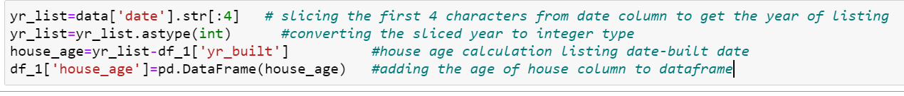
Feature Engineering:
Feature Generation
Calculating the age of the house and adding it as a new column to the original dataframe.
We will use the new feature house_age as a predictor in our model and we get a slightly increased R-Square value 0.7496 and RMSE 186995.19

Slide 12
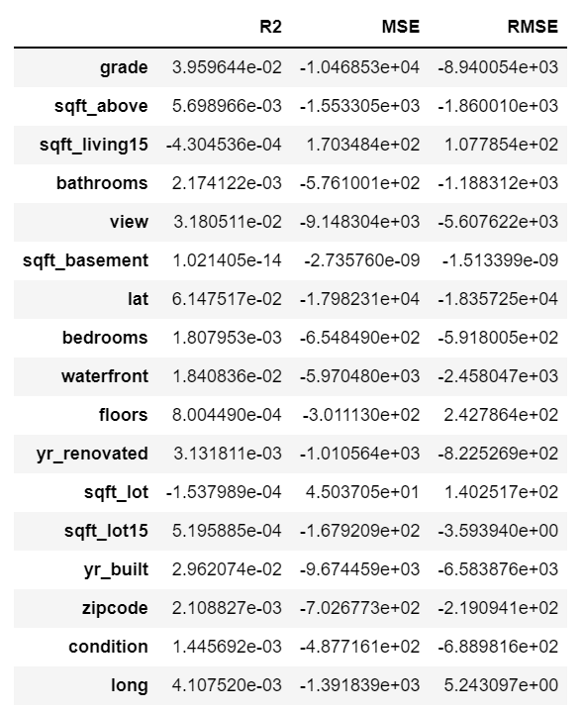
Backward Elimination:
The table on the right hand side shows individual contribution to R-square of each feature when it is added for the first time in MLR model.

Slide 13
Backward Elimination:
So we are removing features which individually contributed less than 0.002 R-square value when they were added. As their contribution to model is negligible.
We find out that 'grade', sqft_above', 'bathrooms', 'view', 'lat', 'waterfront', 'yr_renovated', 'yr_built', 'zipcode', 'long' and 'sqft_living' are the features which contributed the more than 0.002 R-square value.
The Cross validation score for MLR model with above listed features is R-square: 0.6879 and RMSE: 210226.32
We find the p-values of these predictors and find out that if all predictors have significnt p-value (<0.05) individually. And we find out that 'yr_renovated' has p-value: 0.3767. So we remove it from predictors and train a new model.
This new model shows Cross validation scores - R-square: 0.6879 and RMSE: 210234.56, which is very close to result we obtained from model which had ‘yr_renovated' feature as a predictor in the model.
We chceck p-values for all the features of this new model and find out all 10 features have a significant p-value(<0.05).

Slide 14
Decision Tree Regression model:
To find the optimal hyperparameters for Decision Tree Regressor model having the least cv score with RMSE as the metric. We are using nested loops ,one to iterate through different values of max_depth parameter from 1 to 10 and the other to iterate through different values of min_samples_leaf from 1 to 10.
We get the least RMSE for max_depth=9 and min_samples_leaf=4 i.e 177675.5826.
Using optimal hyperparameters to fit the model we get cross validation score with R-square metric as 0.7774 and Mean absolute Error as 96079.1460

Slide 15
Model Testing
As seen in the above table, we have tested our model using 6 Regression models:
Simple Linear Regression Model
Multiple Linear Regression Model using 18 features
Multiple Linear Regression Model using feature transformation
Multiple Linear Regression Model using feature addition
Multiple Linear Regression Model with Backward Elimination (10 features)
Decision Tree Regression Model
Among all these 6 models, we got thhe highest R-square value and lowest RMSE using the Decision tree regression model. Hence, Decision Tree Regression model is the best model here.

